Slide 1

LLM-Guided
Chess Tutoring
— Transforming online chess learning

Slide 2
Table Of Content
Overview
Mixture-of-Agents (MOA)
Challenges
Models tested
Comparison of Generational Capabilities
Cons
Project Pipeline
UI
Future Scope
Dataset Creation
Project Timeline
Target Audience

Slide 3

Overview
LLM-Guided Chess Tutoring - integrates Stockfish’s analytical power with LLaMA 3’s advanced language capabilities to provide real-time, high-level chess feedback in English. By integrating LLaMA 3 70B with Stockfish and utilizing the Syzygy endgame database, the project ensures accurate, engaging feedback. This approach transforms online chess learning, making complex strategies accessible and improving user engagement. This innovative integration offers significant benefits for chess education and beyond.

Slide 4
Models Tested
LLaMA3 8b
LLaMA3 70b
Mixtral 8x7b
Gemma 7b
Gemma 2 9b
6. Claude 3.5 Sonnet
7. ChatGPT 3.5
8. ChatGPT 4
9. ChatGPT 4o

Slide 5
Project Pipeline

Slide 6
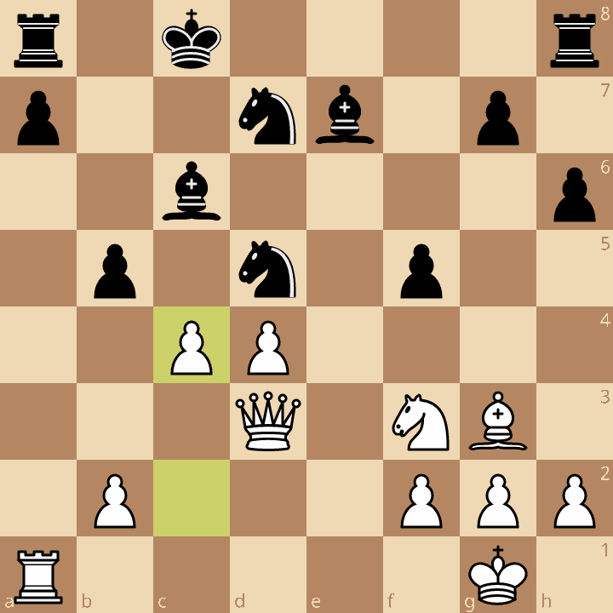

Slide 7
FEN
rnbqkb1r/ppp2ppp/5n2/3pp3/3PP3/2N5/PPP2PPP/R1BQKBNR w KQkq - 0 4
[Event "Garry Kasparov vs Deep Blue: Game 6: Deep Blue - Kasparov"]
[Site "https://lichess.org/study/1tjS4Wyd/eSWarjHL"]
[Result "*"]
[Variant "Standard"]
[ECO "B17"]
[Opening "Caro-Kann Defense: Karpov Variation, Modern Variation"]
[Annotator "https://lichess.org/@/Magno2204"]
[UTCDate "2020.06.18"]
[UTCTime "23:41:16"]
1. e4 c6 2. d4 d5 3. Nc3 dxe4 4. Nxe4 Nd7 5. Ng5 Ngf6 6. Bd3 e6 7. N1f3 h6 8. Nxe6 Qe7 9. O-O fxe6 10. Bg6+ Kd8 11. Bf4 b5 12. a4 Bb7 13. Re1 Nd5 14. Bg3 Kc8 15. axb5 cxb5 16. Qd3 Bc6 17. Bf5 exf5 18. Rxe7 Bxe7 19. c4 *
PGN

Slide 8

BEST MOVE
FEN
ALTERNATIVE MOVE 1
PGN
ALTERNATIVE MOVE 2
SEQUENCE OF BEST MOVES

Slide 9
BEST MOVE
19... bxc4
ALTERNATIVE MOVE 1
19... N5f6
ALTERNATIVE MOVE 2
19... N5b6
SEQUENCE OF BEST MOVES
19... bxc4 20. Qxc4 Nb4 21. Re1 Re8 22. Rxe7 Rxe7 23. Qxb4 Kd8

Slide 10
FEN
PGN
BEST MOVE
SYSTEM PROMPT
ALTERNATIVE MOVE 1
USER PROMPT
ALTERNATIVE MOVE 2
SEQUENCE OF BEST MOVES

Slide 11

SYSTEM PROMPT
OUTPUT
USER PROMPT

Slide 12
Development and Control:
bxc4 opens up the b-file for the rook to potentially use in the future, which could put pressure on White's position.
It also prepares to develop other pieces, such as the bishop on c6, which can now potentially attack White's queen.
Coordination:
bxc4 improves the coordination between the pieces, as it allows the bishop on c6 to potentially attack White's queen, while the rook on b7 can support the bishop.
It also prepares to develop other pieces, such as the knight on d5, which can now potentially attack White's position.
Defensive Strategy:
bxc4 helps to maintain a solid defensive posture by controlling the center and preparing to develop pieces to attack White's position.
It also addresses the potential weakness on the b-file, which could have been exploited by White's rook in the future.
Why bxc4 is the best move:
bxc4 is the best move because it addresses the potential weakness on the b-file, prepares to develop pieces to attack White's position, and improves the coordination between the pieces.

Slide 13
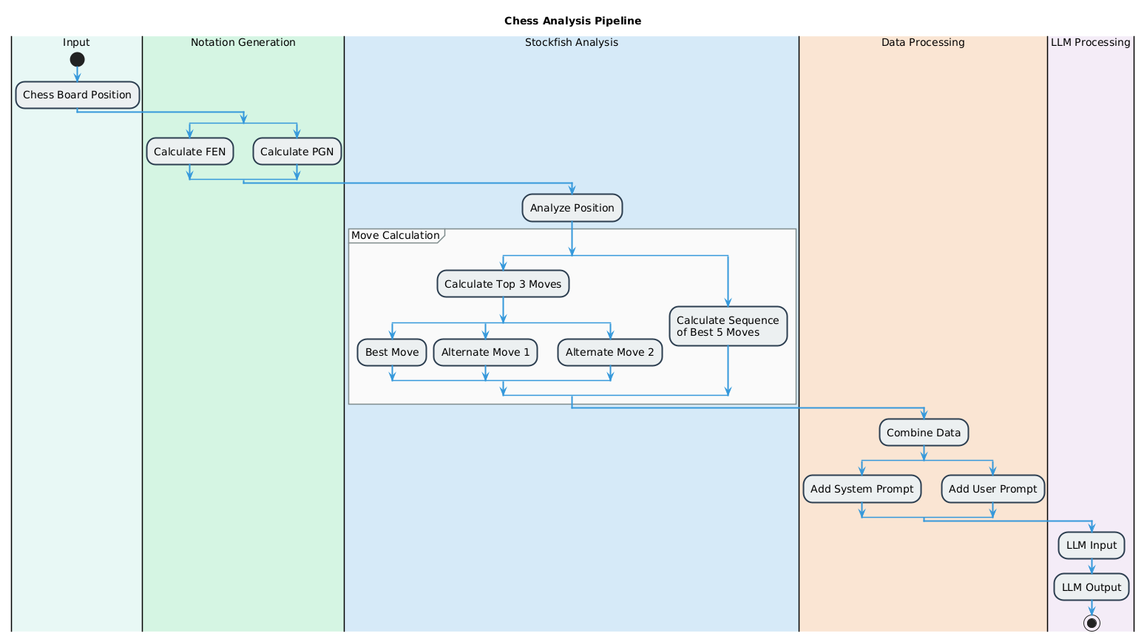

Slide 14
Dataset creation:

Slide 15
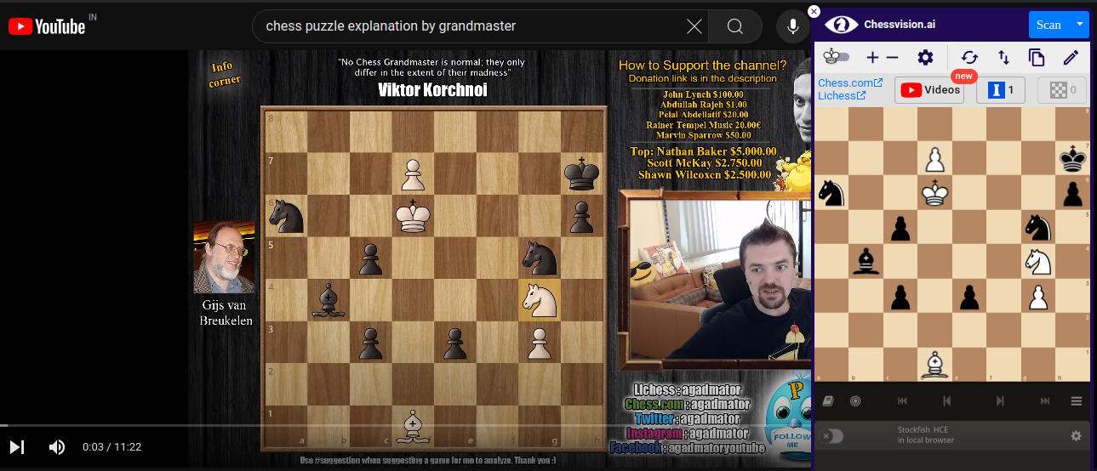
How we created the Dataset?
Chessvision.ai
Lichess
Transcript
Extractor

Slide 16
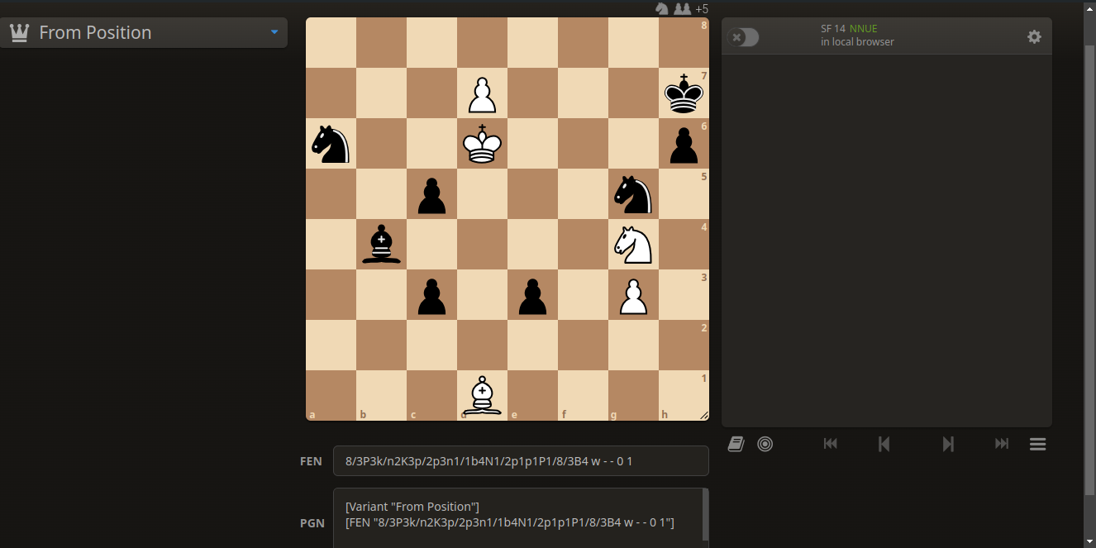
Lichess UI from where we retrieved the corresponding FEN and PGN

Slide 17
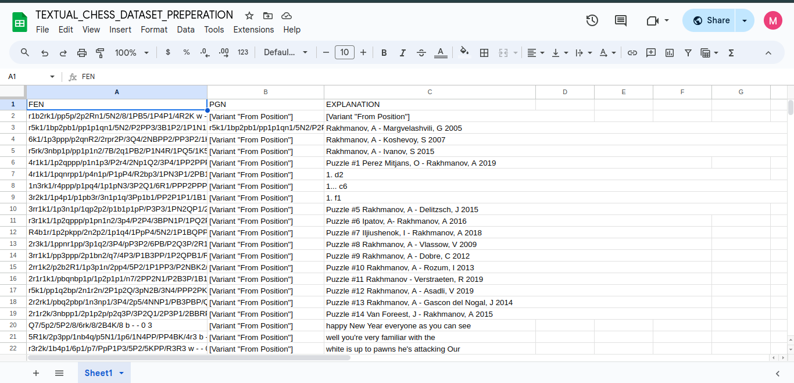
Google Sheet with 100+ Handmade Datasets

Slide 18
Mixture-of-Agents (MOA)
A Mixture of Agents (MOA) involves multiple specialized AI agents working together to solve complex tasks.
It enhances performance and adaptability by combining the unique expertise of diverse agents into a unified solution.

Slide 19
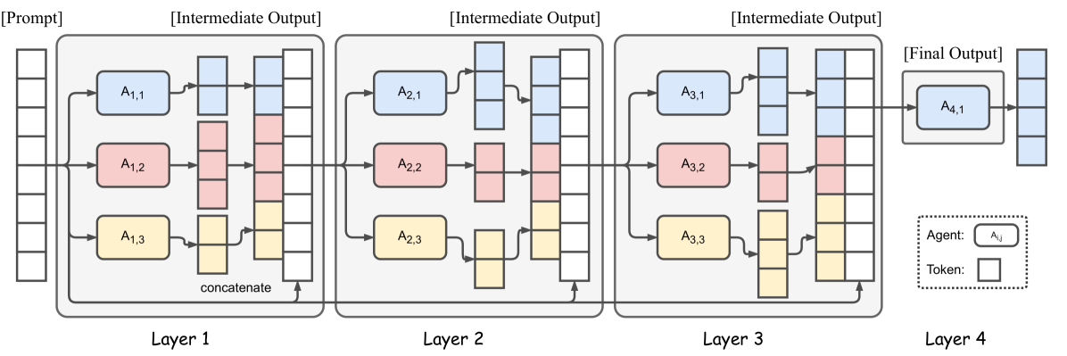

Slide 20
Comparison of Generational Capabilities

Slide 21
Scoring System
Engagement:
Interest: 5%
Tone and Style: 5%
Interest: 5%
Tone and Style: 5%
Human-likeness:
Naturalness: 10%
Contextual Understanding:
Context Awareness: 10%
Chess Concept Explanation:
Clarity and Depth: 30%
Fluency and Grammar:
Correctness: 5%
Readability: 5%
Relevance:
Topic Adherence: 10%
Accuracy:
Factual Correctness: 10%
Diversity and Originality:
Uniqueness: 5%
Length Appropriateness:
Conciseness: 5%
Completeness: 5%

Slide 22
Model | Fluency & Grammar (20) | Relevance (25) | Accuracy (20) | Diversity & Originality (10) | Engagement (15) | Human-likeness (10) | Chess Concept Explanation (35) | Total (100)
LLAMA3 70B | 10 | 10 | 18 | 8 | 13 | 9 | 29 | 97
MOA | 10 | 10 | 18 | 8 | 13 | 9 | 29 | 97
LLAMA3 8B | 10 | 10 | 18 | 8 | 12 | 9 | 28 | 95
MIXTRAL 8X7B | 10 | 10 | 17 | 8 | 12 | 9 | 27 | 93
LLAMA3 8B (4bit) | 10 | 10 | 17 | 7 | 11 | 8 | 27 | 90
GEMMA 7B | 10 | 10 | 15 | 7 | 12 | 8 | 25 | 87
GEMMA2 9B | 10 | 10 | 15 | 7 | 12 | 8 | 25 | 87
LLAMA3 fine-tuned (4bit) | 2 | 5 | 3 | 2 | 2 | 2 | 5 | 21
*Evaluated by ChatGPT 4-o

Slide 23
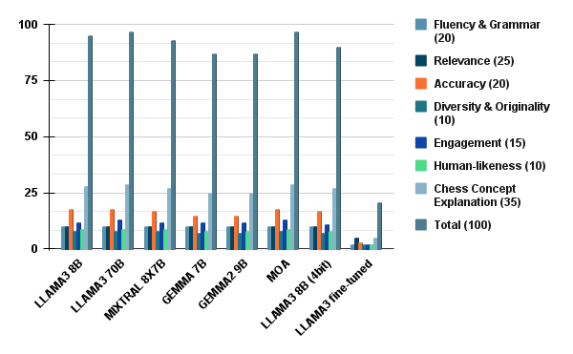

Slide 24
UI

Slide 25
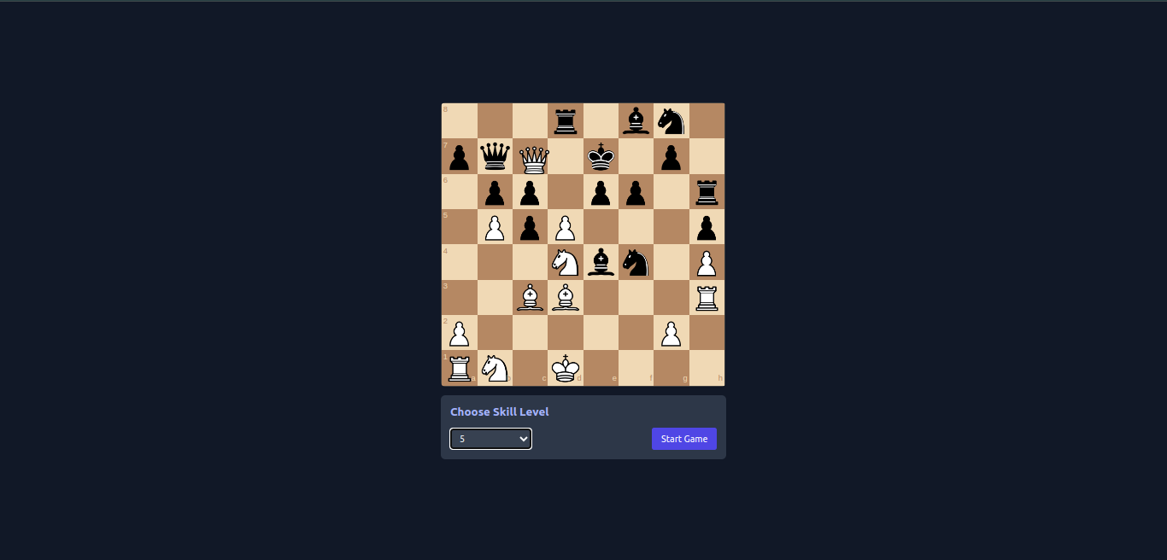
Dynamic Chess board which plays random
Moves
An option to select the Skill level

Slide 26
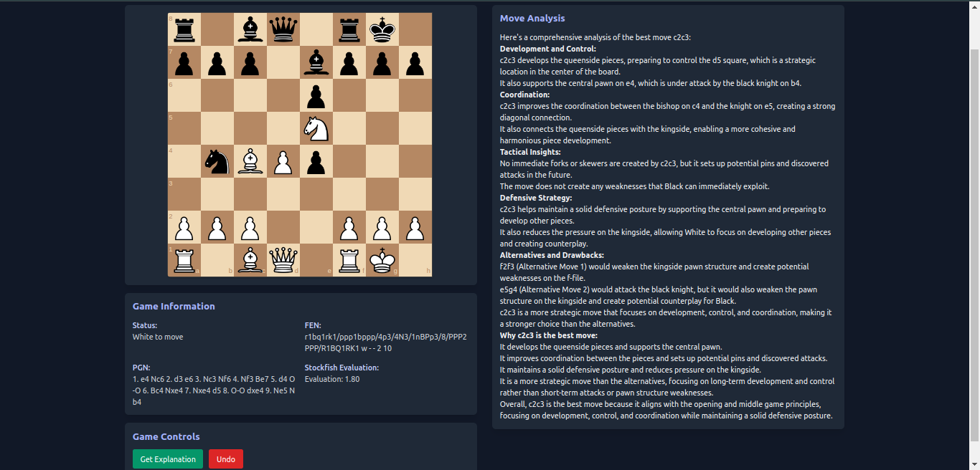

Slide 27
Project Timeline
Llama3 8B Fine tuning
Confirming Llama3 70B using GROQ API
Debugging and Optimization
Pondering Models
Creating the Front End
Fine-tuned Llama3 8B with manual datasets
Due to its efficiency as well as feasibility, we chose Llama3 70B with Groq API as our model
Optimizing Groq as well as Stockfish for faster outputs
Task 2
Task 4
Task 1
Task 3
Task 5
Tried models like Llama3 8B, Gemma 7B, Gemma2 9B, Mixtrel 8X7B
Using HTML, CSS, Javascript , Node.js

Slide 28

Challenges
Lack of quality dataset availability so had to make hand made datasets for fine tuning the Llama3 8B
Lack of GPU access for training purposes
Due to high cost for well performing models like GPT 4-o and Claude 3.5 Sonnet for training and prompting

Slide 29
Cons
“One of the basic rules of the universe is that nothing is perfect.
Perfection simply doesn't exist… without imperfection,
neither you nor I would exist”
- Stephen hawking

Slide 30
Overly technical explanations might overwhelm beginners, while oversimplified explanations might not satisfy advanced players.
Processing complex chess positions and generating detailed natural language explanations in real-time could result in latency, potentially affecting user experience.
Regular updates might introduce compatibility issues that need to be addressed promptly.
Cannot tackle complex ideas like Pawn underpromotion patterns

Slide 31
There are already established chess tutoring platforms and apps that might have a loyal user base.
Ensuring long-term stability and independence from third-party changes is a risk to consider.
Ensuring the language model's explanations align perfectly with Stockfish's evaluations might require extensive fine-tuning and continuous monitoring.

Slide 32

Future Scope

Slide 33
Incorporating interactive puzzles and challenges that dynamically adjust in difficulty based on user performance.
Developing compatibility with physical chess boards and pieces, allowing for hybrid learning experiences that combine digital and physical play.
Offering certification programs and structured courses for different skill levels.
Expanding the platform to include other board games or strategy-based activities, leveraging the same LLM and AI capabilities.

Slide 34
Utilizing data analytics to gain insights into user behavior, learning patterns, and common challenges
Exploring commercial opportunities such as premium subscriptions, personalized coaching services, and branded content.
Implementing features to make chess learning accessible to users with disabilities, such as screen reader support, voice commands, and adaptive interfaces.

Slide 35
Target audience
01 | Children and young learners who are just starting to play chess and need engaging and interactive tutorials.
02 | Intermediates seeking a transition from casual play to more competitive levels
03 | Chess coaches and teachers looking for effective tools to enhance their teaching methods
04 | Educational institutions and chess clubs that want to incorporate advanced AI-driven tutoring into their training programs.
05 | Corporate teams interested in using chess for team-building activities and cognitive skill development.
06 | Bloggers, YouTubers, and streamers who create chess-related content and need advanced tools for game analysis and explanation
07 | Retirees looking for engaging and intellectually stimulating hobbies

Slide 36
Thank you.

